Slide 1



Central
Arizona
College
Solar Power for High-Altitude Balloon Payloads
Nathaniel Faint, Henry Luna, Attalie Faint, Moriah Faint

Slide 2
Fall 2015
Used small solar panel to successfully recharge digital camera battery.
Flew Basic Stamp & collected valid data from its sensors.
Payload weight: 0.8 lbs.

Slide 3
Spring 2016 Objectives
Power Basic Stamp with solar panels.
Correlate power produced by panels to available light with a separately powered Arduino system.
Gather GPS data during flight.
Capture high-quality video with lightweight camera (we chose the Mobius Actioncam).

Slide 4
Payload Construction
Enclosure design was based on solar panel size.
Solar array consisted of 6 thin-film panels wired in parallel (this adds amperage).
Camera was mounted facing down.
Payload weighed 1.27 lbs.

Slide 5
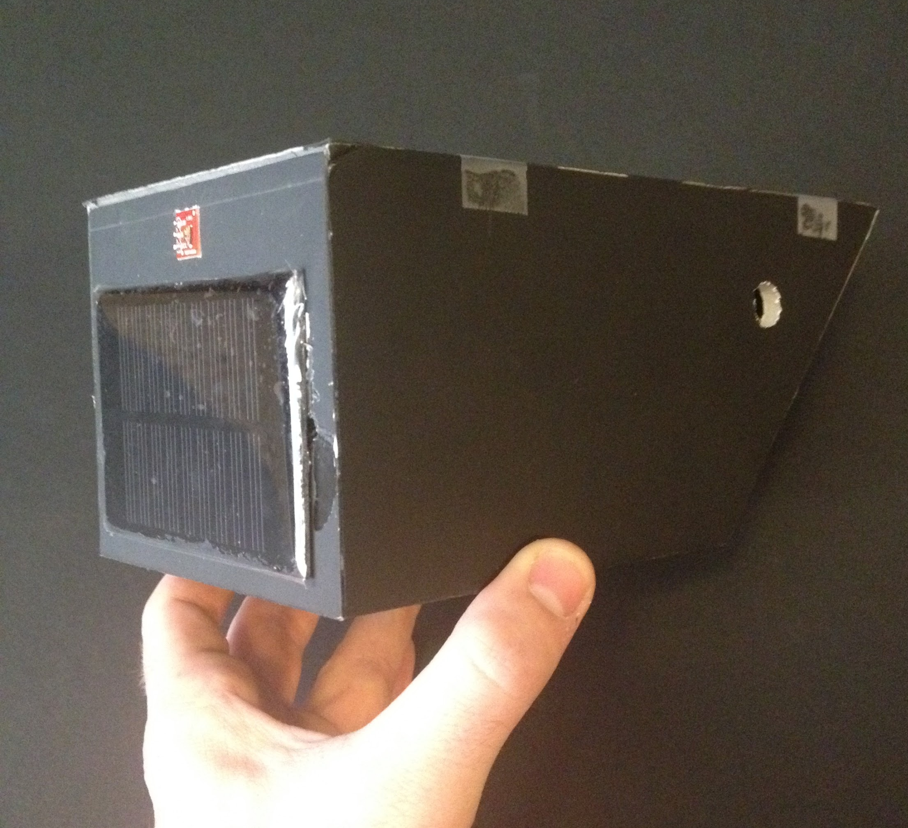
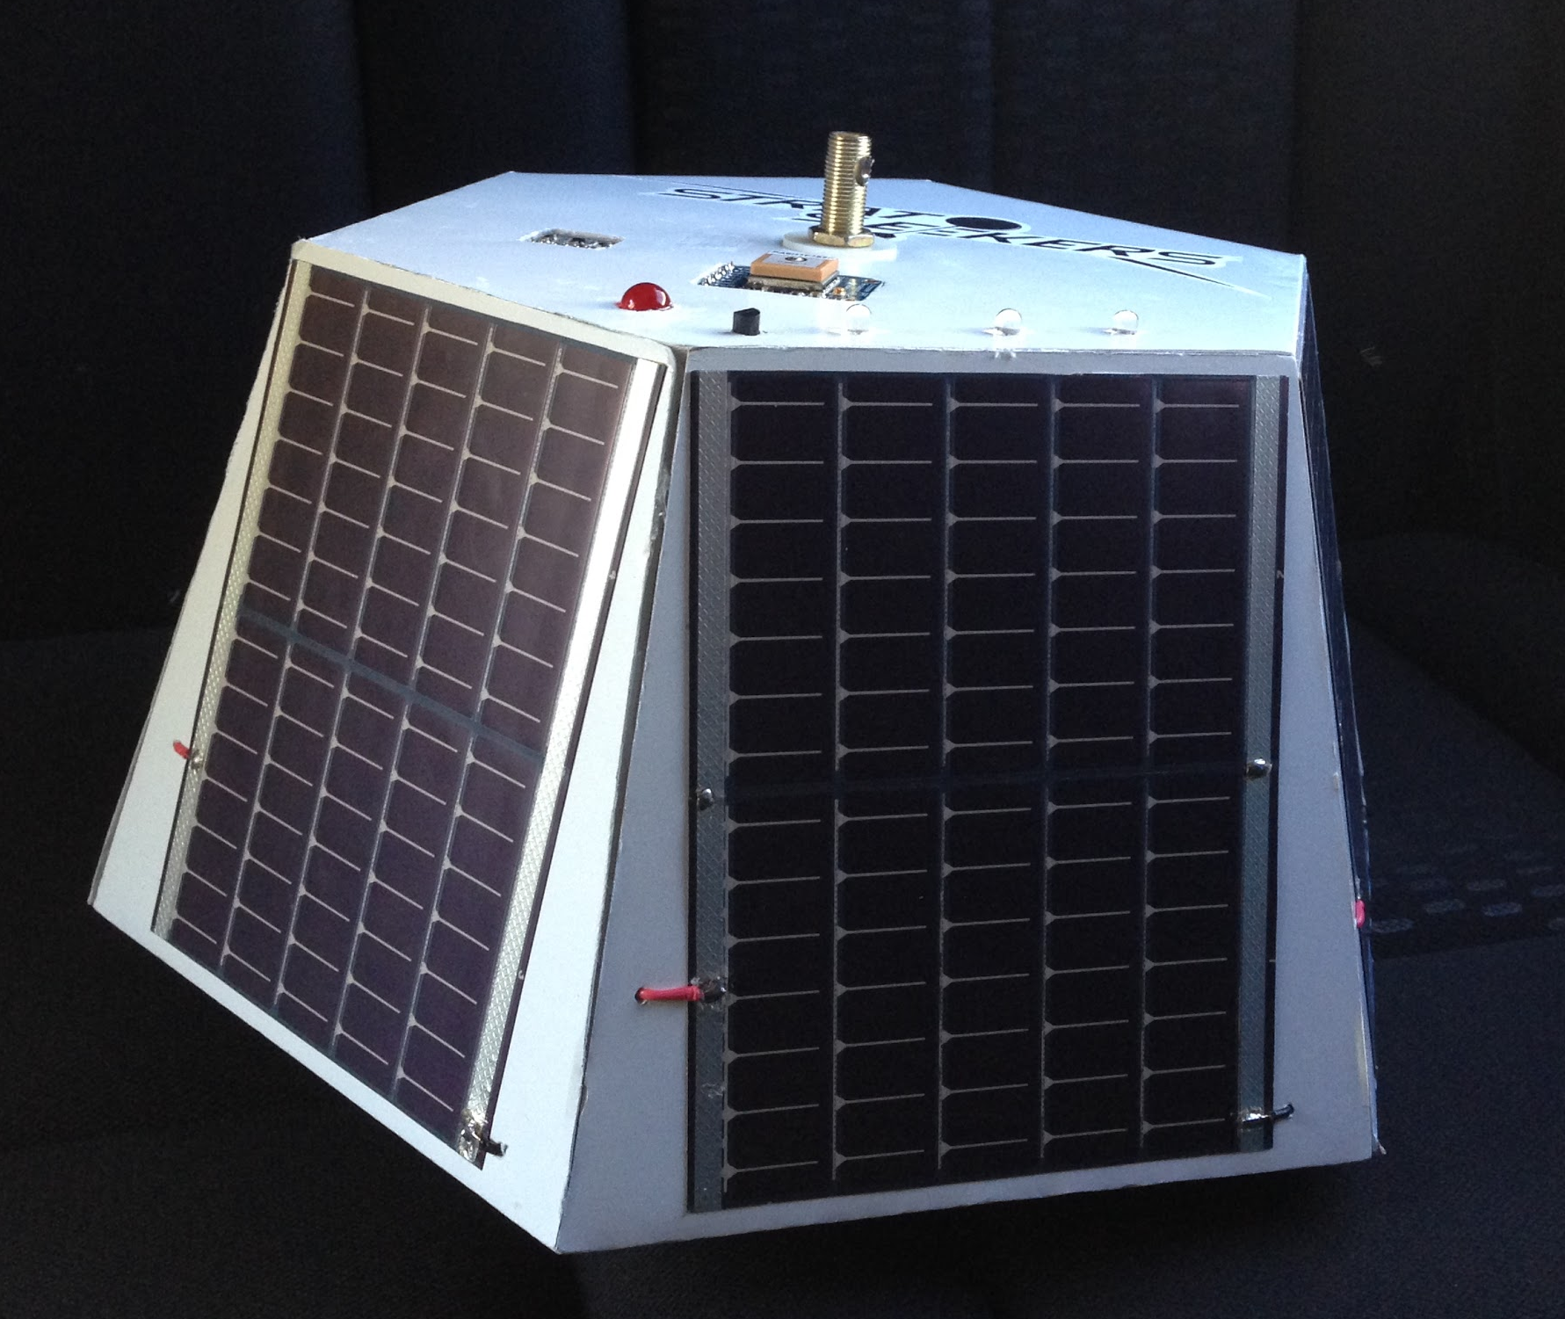
Payloads
Last semester...
This semester

Slide 6
Measuring Solar Efficiency
Light sensor measured luminosity (in lux).
In-line current sensor measured volts and amps from solar array.
The two sensors would have enabled us to compare available light to power output from solar array.

Slide 7
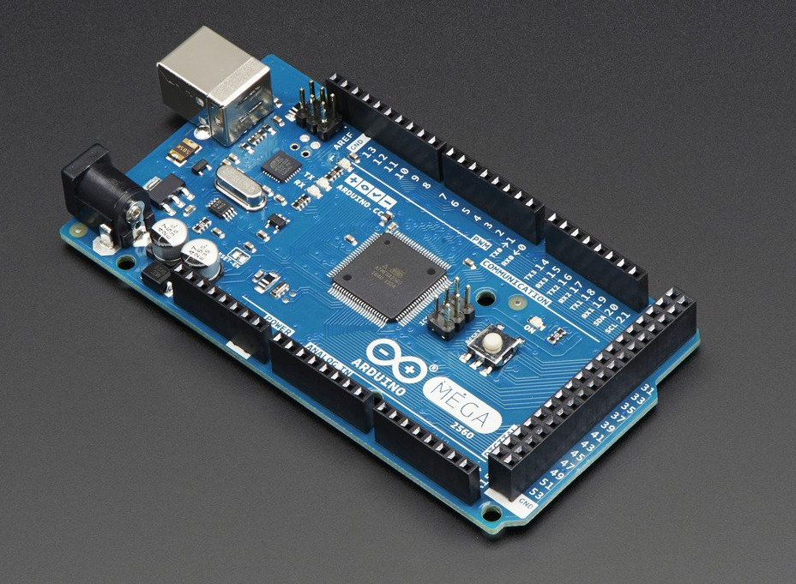
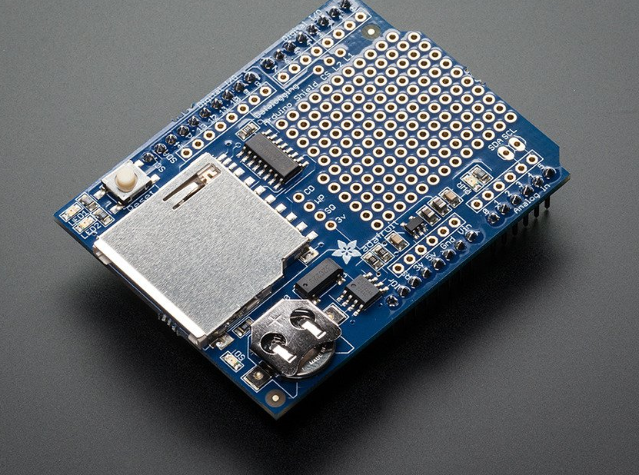
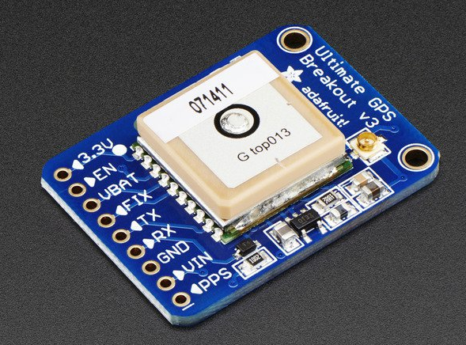
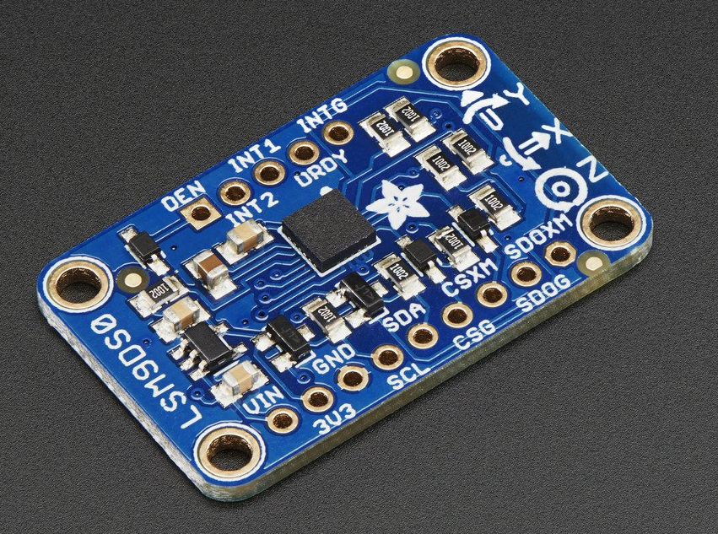
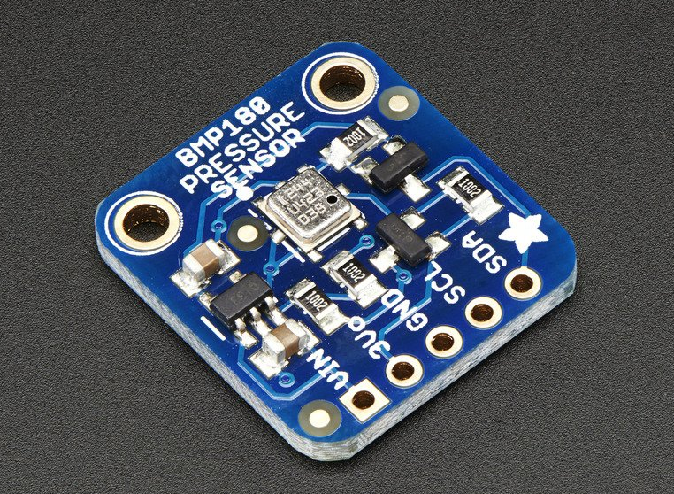
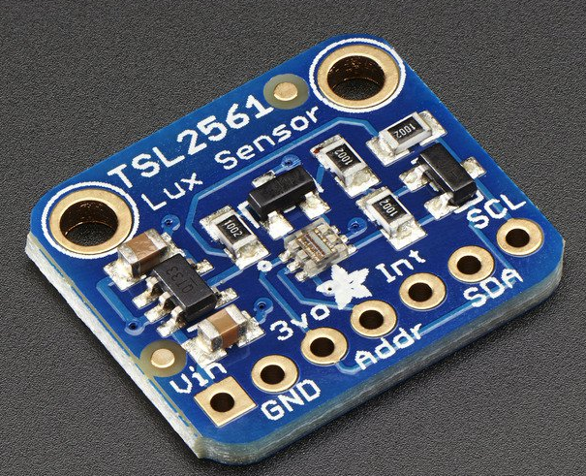
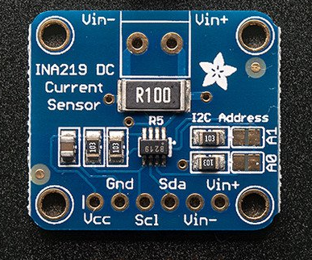
Arduino System
Arduino Mega
SD Shield
GPS
9 DOF
Pressure
Ambient Light
Current

Slide 8
Flight Results
Basic Stamp took four data readings then failed due to software issues.
Current sensor also gave faulty data.
All other data were valid.
Mobius camera recorded clear video.

Slide 9
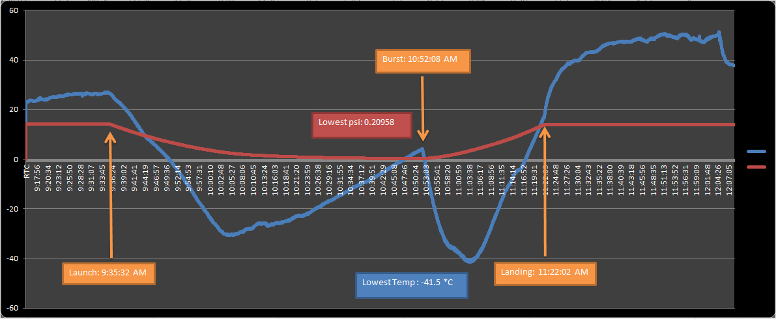
Flight Data Graph

Slide 10
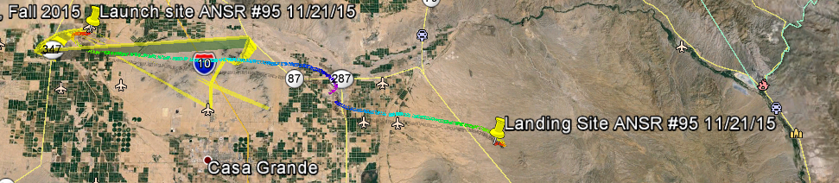
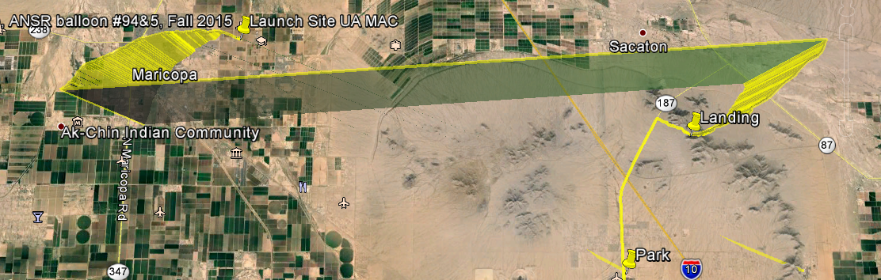

Slide 11
Conclusions
Solar panels will provide power comparable to a heavy battery.
Solar power is a great way to conserve weight and space on a payload.
The Mobius is a good lightweight camera option.

Slide 12
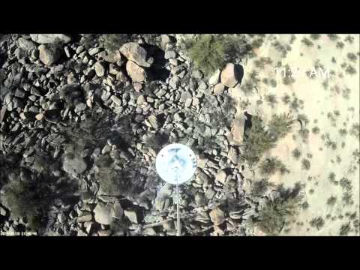

Slide 13
Acknowledgments:
Arizona Space Grant Consortium
Our Professors: Tammy Janisko & Dr. Pryor
Mr. Crabtree & ANSR Volunteers
Fellow Students
Paul McWhorter at toptechboy.com
Jeremy Blum at jeremyblum.com
Adafruit.com
https://sites.google.com/site/stratoseekersascendfall2015/home

Slide 14
Thank You!

